Slide 1
AI-Driven Hyper-Personalization and Recommendations System

Slide 2
Problem statement
Modern customers highly personalized experience that cater to their unique preferences. in this hackathon participants will develop a generative AI-driven solution that enhance hyper-personalization by analyzing customer profiles, social media activity, purchase history, sentiment data and demographic details.
The challenge is to design a system that generate personalized recommendations for products, services, or content while also providing actionable insights for business to optimize customer engagement.
Importance of Hyper-Personalization
Hyper-personalization is a step beyond traditional personalization—it leverages real-time data, AI, machine learning models, and advanced analytics to deliver highly tailored experiences, products, and services to individual users based on their unique preferences, behaviors, and needs.
Key Reasons Why Hyper-Personalization is Important
Enhanced Customer Experience
Improved Conversion Rates & Sales
Stronger Customer Retention & Loyalty
Increased ROI on Marketing & Engagement Efforts
Competitive Advantage
Data-Driven Decision Making
Supports Omnichannel Strategy

Slide 3
Solution Overview: AI-Driven Hyper-Personalization System
To build an advanced, real-time AI system that delivers hyper-personalized product, service, and content recommendations by analyzing diverse customer data points—such as profiles, purchase history, sentiment, social activity, and demographics—while also providing actionable business insights.
Architecture Overview:
Data Ingestion Layer:
Sources:
Transaction history via secure APIs
Social media feeds (Twitter, Facebook APIs)
Customer profiles & demographic details
Real-time customer interactions

Slide 4
Preprocessing Layer:
Data cleaning, normalization & anonymization
Compliance checks & tokenization of PII
Sentiment data extraction (social media, reviews)
Multi-Modal Embedding Layer:
Text: BERT/GPT-based embeddings
Image: CLIP model embeddings for social media/past purchase images
Voice: OpenAI Whisper API → Speech-to-text → Text embeddings
Sentiment & Risk Analysis Module:
Sentiment Classifier: Fine-tuned BERT/DistilBERT models
Churn Prediction: XGBoost & Random Forest classifiers
Anomaly Detection: Isolation Forest for suspicious transactions
Customer Lifetime Value (CLV) & Engagement Drop Prediction

Slide 5
Recommendation Engine
LLMs (GPT-4-turbo, fine-tuned) for generating natural language recommendations
Retrieval-Augmented Generation (RAG): Combining real-time customer data + embeddings
RLHF (Reinforcement Learning with Human Feedback): Dynamically fine-tuning recommendations based on interactions
Vector Store Integration: FAISS/Chroma for similarity search
Business Insights Dashboard:
Visualizations:
Churn risk
Predicted engagement scores
Product interest patterns
Risk & anomaly alerts
Actionable insights for business teams

Slide 6
Real-Time Interactive UI (Streamlit Web Interface):
Users can input profile info, text, images, or voice data
Receive dynamic, hyper-personalized recommendations instantly
Business dashboard for visual insights
Key AI Models & Tools:
Task | Model/Tool
Sentiment Analysis | Fine-tuned BERT, DistilBERT (Hugging Face)
Text Recommendations | GPT-4-turbo (OpenAI API)
Image Understanding | CLIP (Hugging Face)
Voice Input | OpenAI Whisper API
Churn Prediction | XGBoost, Random Forest
Anomaly Detection | Isolation Forest (sklearn)
Retrieval + Search | FAISS / Chroma
RL Fine-tuning | RLHF approach

Slide 7
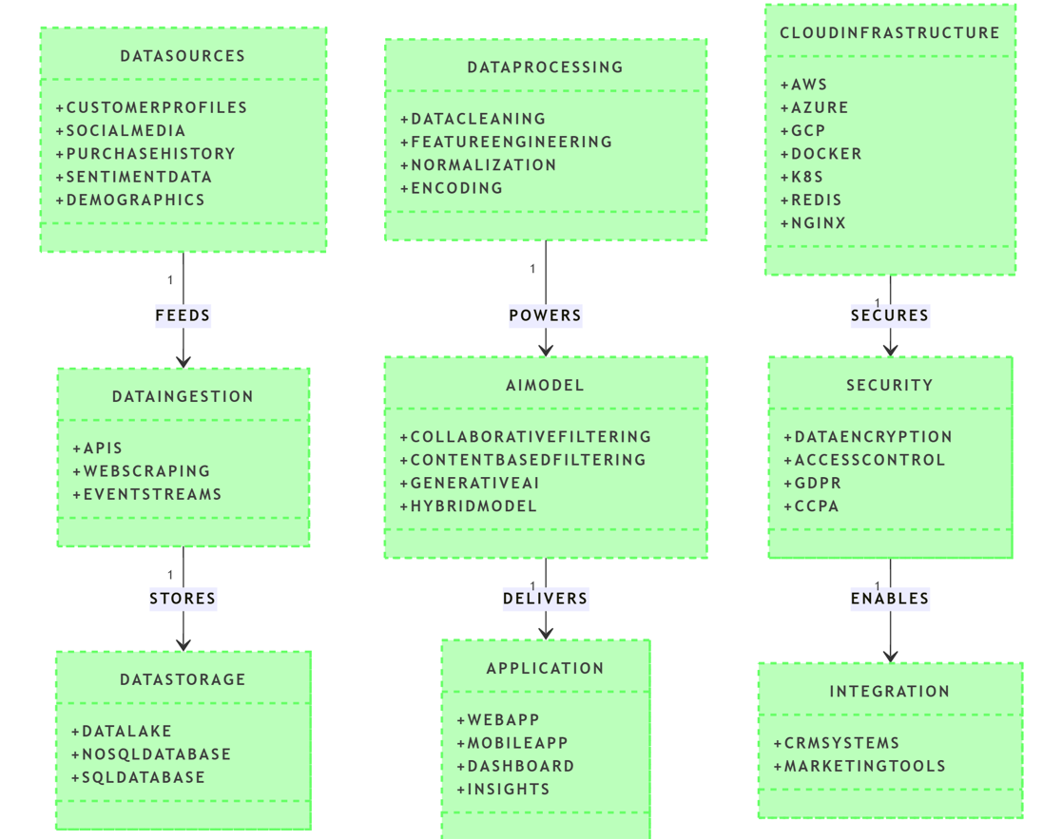
System Diagrams

Slide 8
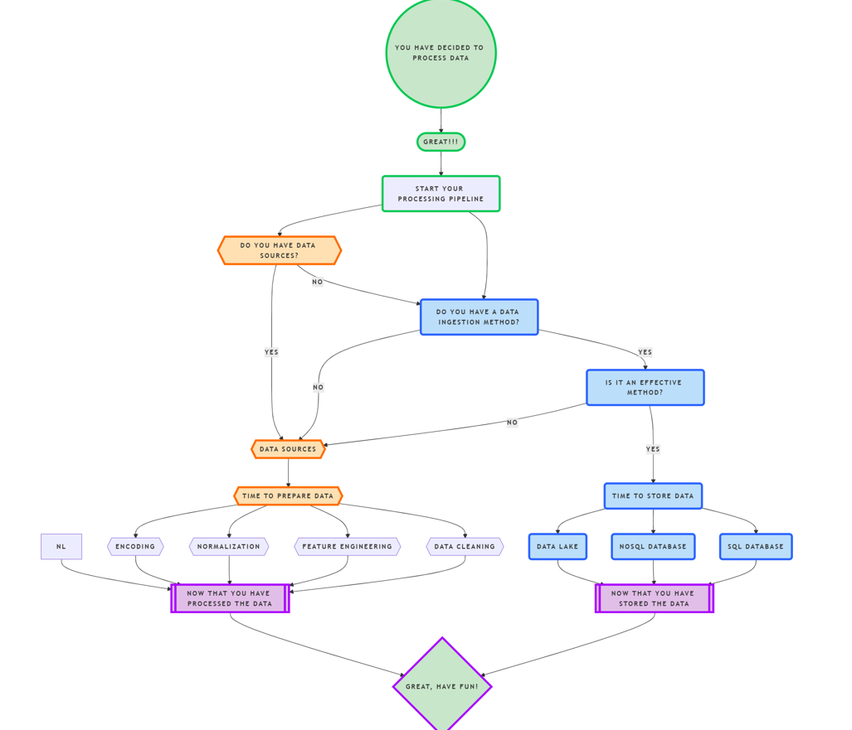

Slide 9
Data Sources & Preprocessing
Types of data used:
Customer profiles
Social media activity
Purchase history
Sentiment data
Demographics
Preprocessing steps
Anonymization
Normalization
Noise removal
Training Methodology & Hyperparameter Tuning
Datasets used
Training details
Hyperparameter tuning strategies
Reinforcement learning feedback loop setup
Evaluation metrics (Precision, Recall, F1-score, engagement rates)

